Slide 1

Credibility and reproducibility in economics & management

Slide 2
Introduction
PhD candidate at Organization Studies
Main interest: Behavioral strategy / Organizational Sociology
Hobby: science on science / open science

Slide 3
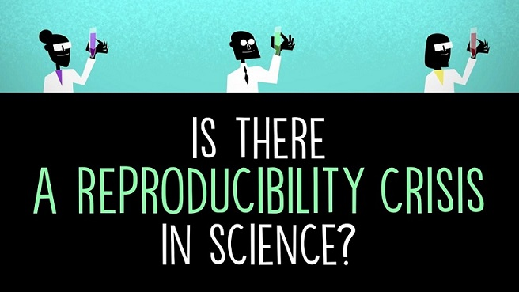
Reproducibility: a hype to pass?
God blessed them and said to them, “Be fruitful and reproduce” (Genesis 1:28, 9:1)

Slide 4
Today’s agenda
Times of crisis: replication, credibility, and reproducibility
Assessing credibility and reproducibility
Increase your own credibility and reproducibility

Slide 5
Definitions
“…I define “replication” as independent people going out and collecting new data and “reproducibility” as independent people analyzing the same data.” (Peng, 2011)
Replication: Collect new data from similar population using similar methods (stimuli) and analytic techniques
Reproducibility: Reanalyze same data from conducted study
Credibility: The extent to which outcomes of research are trustworthy

Slide 6
Replicability
Large, collaborative projects show that effects do not replicate
  36% (35/97) effects replicated (OSC, 2015)
  62% (13/21) effects in Nature & Science replicated (Camerer et al., 2018a)
  Experimental economics: 61% (11/18) replicated (Camerer et al., 2018b)
Many findings in the literature do not seem to describe ‘true’ phenomena

Slide 7
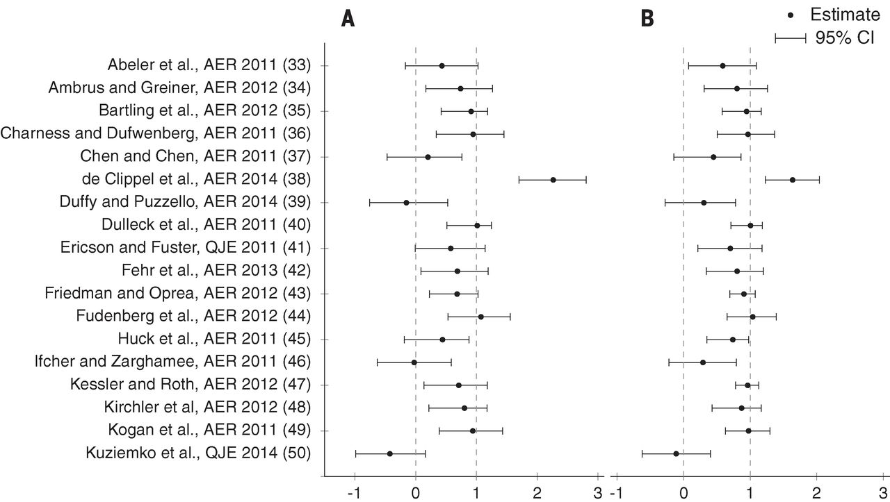
Replication in Economics (Camerer et al., 2016)

Slide 8
Reproduciblity: Statistical inconsistencies
Study on the reproducibility of findings in Strategic Management Journal by Bergh et al. (2017)
Reproduction based on descriptive statistics (M, SD, N, r) using corr2data in STATA

Slide 9
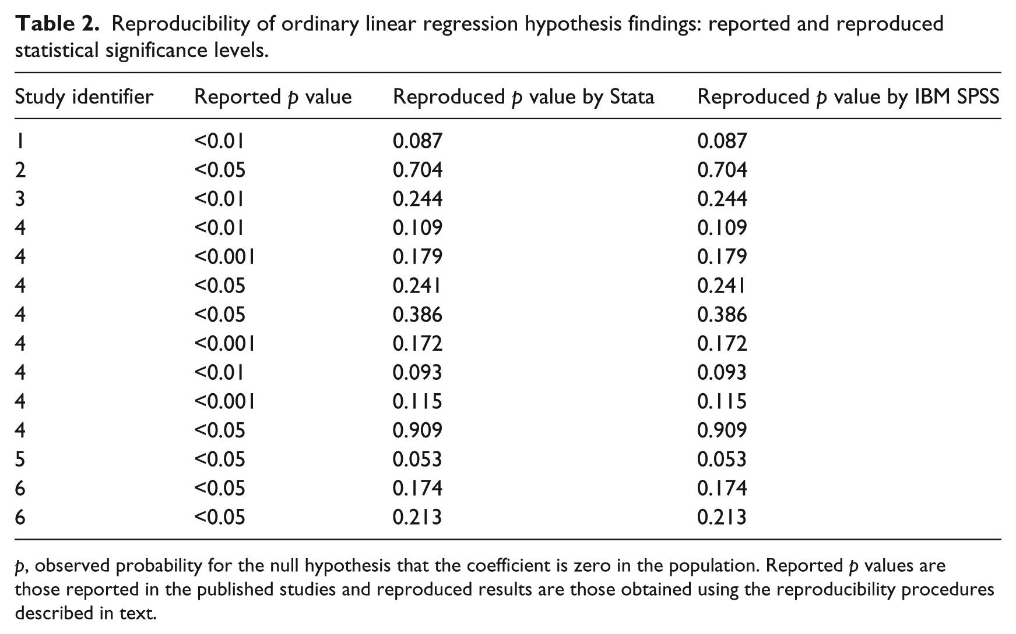
Reproduciblity: Statistical inconsistencies

Slide 10
Reproduciblity: Statistical inconsistencies
Study on the reproducibility of findings in Strategic Management Journal by Bergh et al. (2017)
Reproduction based on descriptive statistics (M, SD, N, r) using corr2data in STATA
“one-third reported hypotheses as statistically significant which were no longer so and far more significant results were found to be non-significant in the reproductions than in the opposite direction.” (Bergh et al., 2017)

Slide 11
Reproduciblity: Statistical inconsistencies
Statistical inconsistencies: reported test statistics are incongruent
  F-value, df, and p-value
  Beta, SE, and p-value
In psychology: 1 in 8 papers contains a gross inconsistency (Nuijten et al., 2016)
In innovation research: 1 in 2 papers contains a gross inconsistency (Bruns et al., 2019)
Business/management: similar results (van Zelst & Smeets, wip)

Slide 12
Credibility
Credibility: The extent to which outcomes of research are trustworthy
Do you automatically trust research because it is published in a peer-reviewed journal?
Based on the aforementioned evidence:
You should stop doing that!

Slide 13
Credibility
Credibility: The extent to which outcomes of research are trustworthy
Do you automatically trust research because it is published in a peer-reviewed journal?
Based on the aforementioned evidence:
You should stop doing that!
You can quantify the credibility of published results
  Example: Excess significance

Slide 14
Excess significance
Credibility: The extent to which outcomes of research are trustworthy
Power: the probability of finding a significant result given that the alternative hypothesis is true
Independent-samples t-test, d = 0.3, alpha = 5%, power = 80%
Required sample = 352
Independent-samples t-test, d = 0.5, alpha = 5%, sample size = 60
Power = 48%

Slide 15
Excess significance
Credibility: The extent to which outcomes of research are trustworthy
% of significant results:
  When testing true hypothesis 100% of the time
  With alpha = 5%
  And power = 80%
80%
% of significant results:
  When testing true hypothesis 50% of the time
  With alpha = 5%
  And power = 80%
42,5%

Slide 16
Excess significance
Credibility: The extent to which outcomes of research are trustworthy
% of significant results:
  When testing true hypothesis 100% of the time
  With alpha = 5%
  And power = 80%
80%
% of significant results:
  When testing true hypothesis 50% of the time
  With alpha = 5%
  And power = 80%
42,5%
Typical power in psychology: ~50% (Fraley & Vazire, 2014)
Percentage of tests that are significant: ~90% (Sterling, 1995)

Slide 17
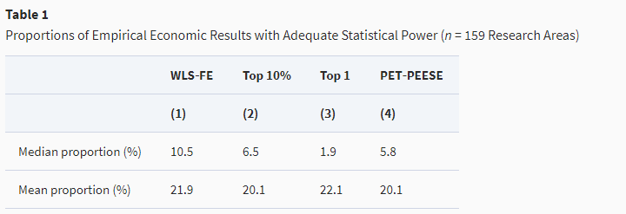
Excess significance
Credibility: The extent to which outcomes of research are trustworthy
Median statistical power in empirical economics: ~18% (Ioannidis, Stanley, & Doucouliagos, 2017)

Slide 18
Excess significance
Example: only significant results
  7 statistical tests, all significant
  100 participants, d = 0.5
1) Calculate power: 70%
2) Calculate likelihood of finding 7 significant findings:
0.7 x 0.7 x 0.7 x 0.7 x 0.7 x 0.7 x 0.7 = 0.082
8.2% chance of finding only significant effects across 7 studies with 70% power

Slide 19
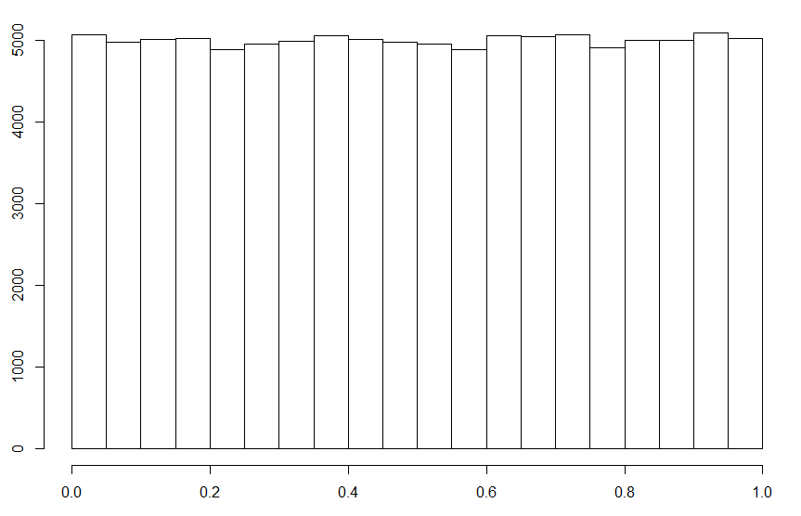
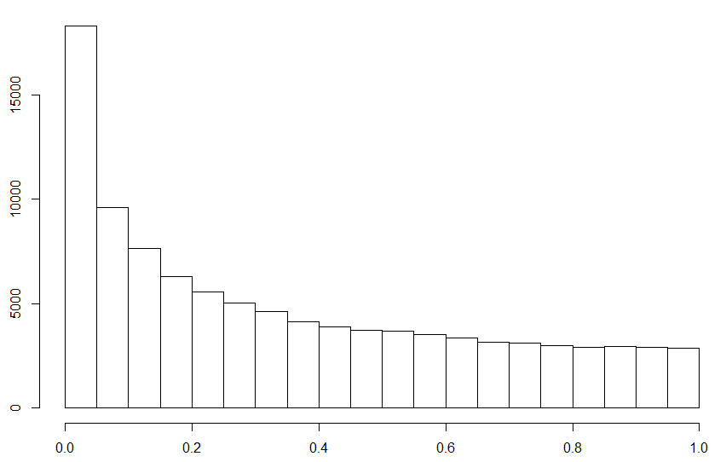
Distribution of p-values
d = 0
d = 0.15

Slide 20
Distribution of p-values
Higher fWHR for:
DOWJones CEOS vs. controls p = .014
DAX CEOs vs. controls p = .094
NGO CEOS: vs. controls p = .006
Popes vs. controls p = .023
Correlations:
DOWJones CEO fWHR employee satisfaction p = .015
DOWJones CEO fWHR CEO approval p = .042
DOWJones CEO fWHR charitable donations p = .033
DOWJones CEO fWHR sustainability index p = .064

Slide 21
Distribution of p-values
8 findings with p values between .006 and .094
~d = 0.8
~n = 30
Likelihood of 1 p value in observed range: 28.57%
Likelihood of 8 p values in observed range: 0.054%
0.054% chance of observing this set of p values given the effect is true

Slide 22
P-hacking (psychology)
Recruited 34 participants, but some were excluded
Chronological rejuvenation study
20 university students
Listen to ‘When I’m Sixty-Four’ or ‘Kalimba’
Indicated their birthday and their father’s age (which was included to control for baseline age differences)
‘people were nearly a year-and-a-half younger after listening to “When I’m Sixty-Four” (adjusted M = 20.1 years) rather than to “Kalimba” (adjusted M = 21.5 years), F(1, 17) = 4.92, p = .040.’
A third condition was dropped
11 more variables (such as mother’s age) were also measured
Not significant without the covariate
Simmons, Nelson, & Simonsohn (2011)

Slide 23
P-hacking (management)

Slide 24
P-hacking (management)
Adapted from Baum and Bromiley (2019)

Slide 25
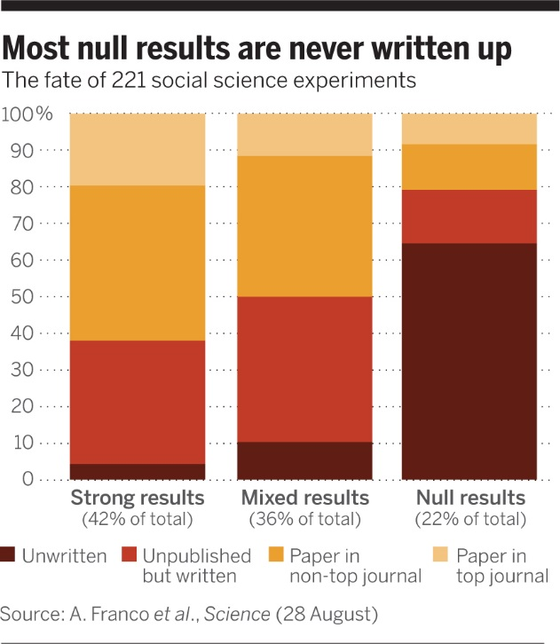
Publication bias in social sciences (Mervis, 2014)

Slide 26
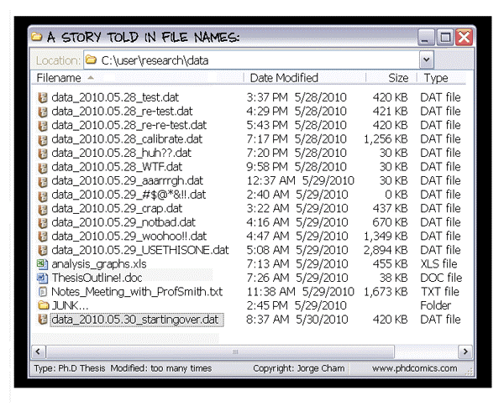
Finally, one practical problem

Slide 27
‘Inadequate record keeping or data management related to research projects’
  27,5% (Martinson et al., 2005)
  48%! (Godecharle et al., 2017)

Slide 28
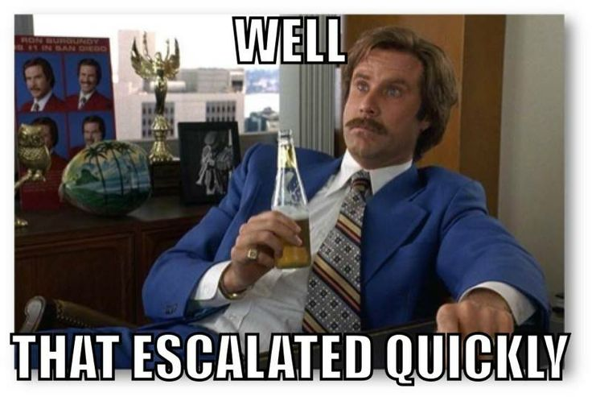
‘Inadequate record keeping or data management related to research projects’
  27,5% (Martinson et al., 2005)
  48%! (Godecharle et al., 2017)

Slide 29
So we know it’s bad..
How about some solutions?

Slide 30
Responsible research conduct
Transparency
&
Accountability
Notes:
--> The baseline should always be that data should be shared, except if for some good reason.

Slide 31
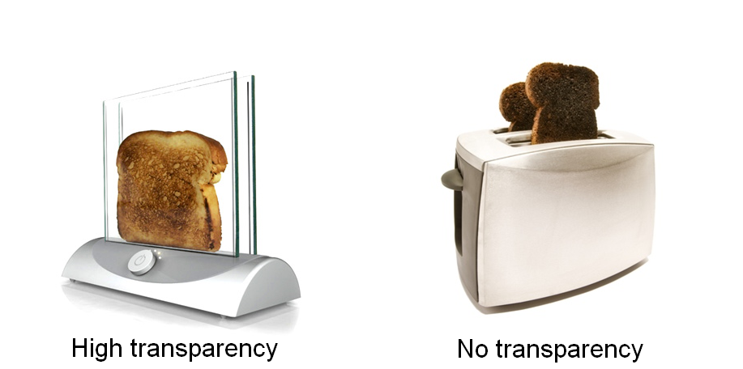
Responsible research conduct
Transparency
&
Accountability
Notes:
--> The baseline should always be that data should be shared, except if for some good reason.

Slide 32
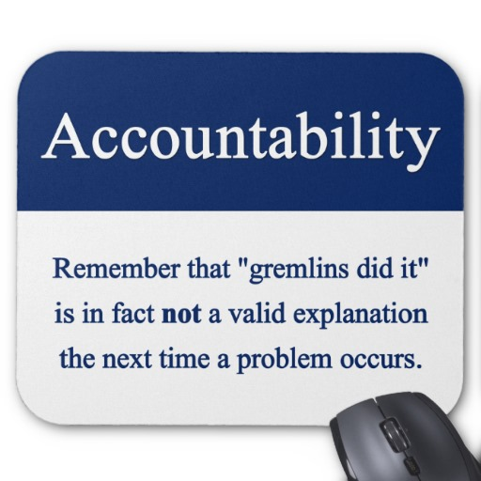
Responsible research conduct
Transparency
&
Accountability
Notes:
--> The baseline should always be that data should be shared, except if for some good reason.

Slide 33
Some personal advantages of being open
OA publications have higher citation rates (Tennant et al., 2016; Piwowar et al., 2018)
“Economics journals with reproducibility policies are cited more often than others.” (Höffler, 2017, AER)
“I appreciate the fact that you registered your hypotheses and data in a public database” (personal comm. with SMJ editor during R&R)
Scooping paradox: when open, you have proof you were the first
Notes:
--> The baseline should always be that data should be shared, except if for some good reason.

Slide 34
Say that you wake up one morning with full amnesia related to your current project, but you are still a very capable scientist. Are you able to understand what you did the day before?

Slide 35
How does one achieve T&A?
Today, we’ll focus on three things:
Version control
Preregistration
Reproducibility
Notes:
--> The baseline should always be that data should be shared, except if for some good reason.

Slide 36
A user-friendly platform: OSF
Open Science Framework
Online environment
Version control
Preregistration
Can make files public but not mandatory
Watch out: US servers (privacy!)
More advanced? Github/Bitbucket
Notes:
--> The baseline should always be that data should be shared, except if for some good reason.

Slide 37
How does one achieve T&A?
Version control
=
Track changes for files
Notes:
--> The baseline should always be that data should be shared, except if for some good reason.

Slide 38

‘Normal’ version control
Adapted from Hartgerink (2016): http://bit.ly/chrisPM101

Slide 39
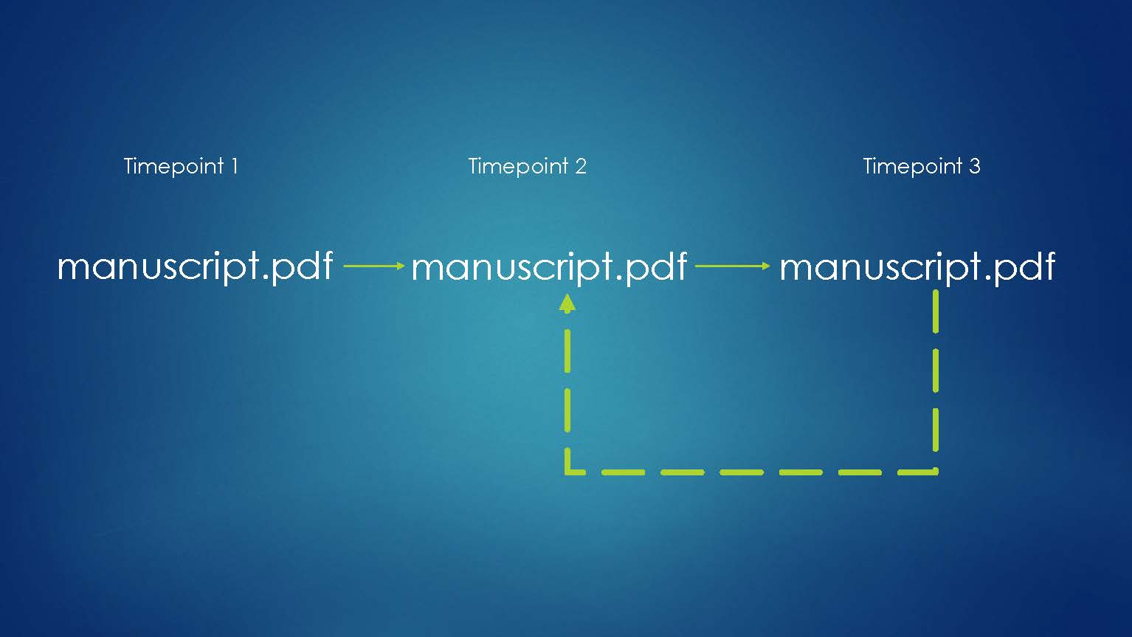
Actual version control
Adapted from Hartgerink (2016): http://bit.ly/chrisPM101

Slide 40
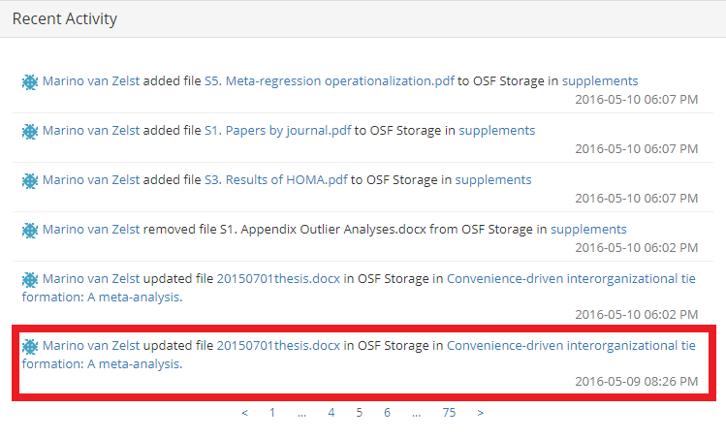

Slide 41
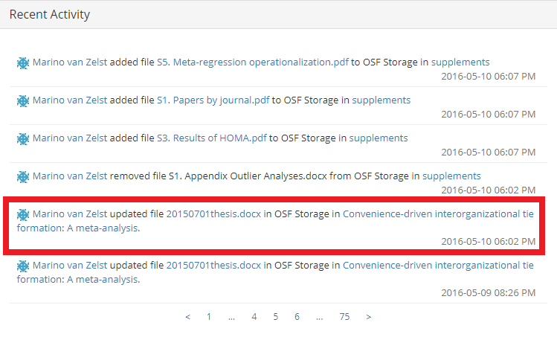

Slide 42
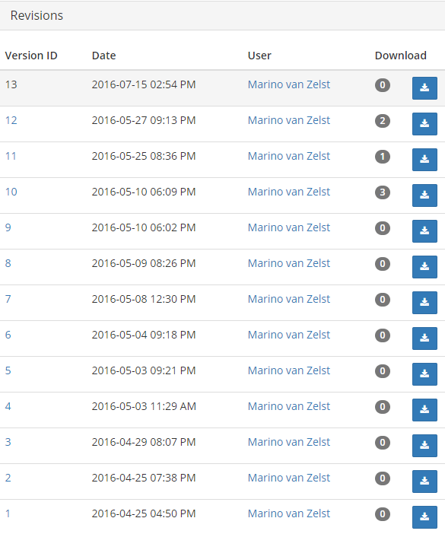

Slide 43
Preregistration
Preregistration limits HARKing which is still practiced a lot (Banks et al., 2016; Bosco et al., 2016)
Publicly register confirmatory and exploratory hypotheses/data collection/analyses/etc.
“In a world of transparent reporting, I choose preregistration as a way to selfishly show off that I predicted the outcome of my study.” (Datacolada.org, 2014)
Notes:
--> The baseline should always be that data should be shared, except if for some good reason.

Slide 44
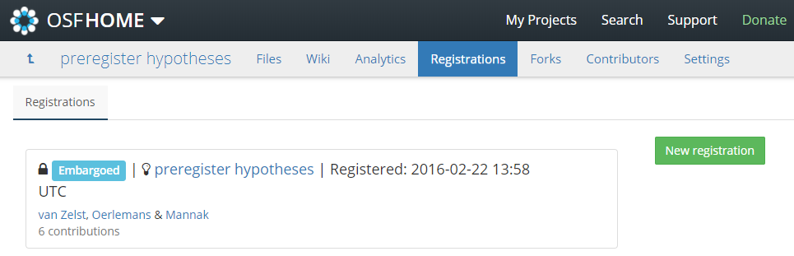
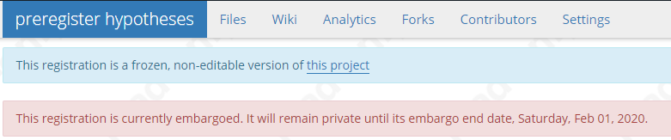

Slide 45
How does one achieve transparency?
Ask ourselves continuously:
Can my future-self or anyone else reproduce this result within a reasonable amount of time?

Slide 46
Reproducibility
Data package requires you to:
Be able to reproduce all your results in reasonable amounts of time
Notes:
--> The baseline should always be that data should be shared, except if for some good reason.

Slide 47
Reproducibility
Data package requires you to:
Be able to reproduce all your results in reasonable amounts of time
Use syntax for everything!
Log WHY you use specific syntax
Notes:
--> The baseline should always be that data should be shared, except if for some good reason.

Slide 48
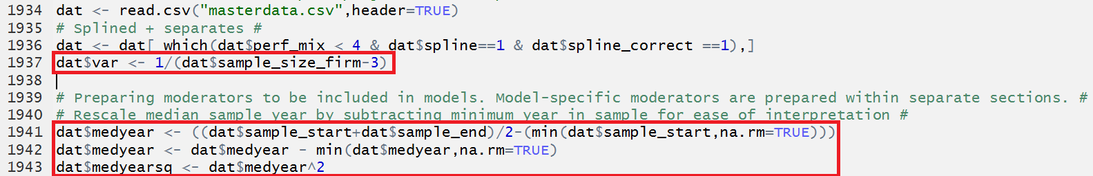
Reproducibility

Slide 49
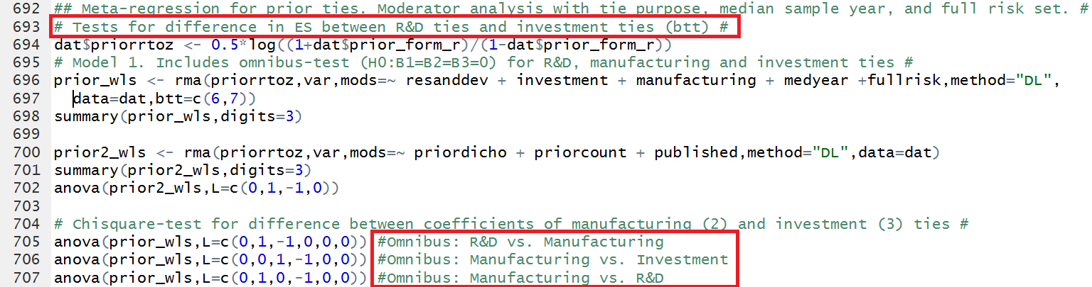

Slide 50
Reproducibility
The future: dynamic documenting
knitR, Rmarkdown
Code: Responses to historical performance feedback are heterogeneous, as the Q-statistic is `r round(all.hpfb_dv$QE,3)` (*p*-value = `r round(all.hpfb_dv$QEp,3)`)
Text: Responses to historical performance feedback are heterogeneous, as the Q-statistic is 392.468 (p-value = 0.003)

Slide 51
1) Will you be capable of reproducing your own results in half a year from now?

Slide 52
1) Will you be capable of reproducing your own results in half a year from now?
2) Will your co-authors be able to do this?

Slide 53
1) Will you be capable of reproducing your own results in half a year from now?
2) Will your co-authors be able to do this?
3) Will a colleague that is not a co-author?

Slide 54
1) Will you be capable of reproducing your own results in half a year from now?
2) Will your co-authors be able to do this?
3) Will a colleague that is not a co-author?
4) An independent researcher who’s
in your field of expertise?

Slide 55

'Openscience'isjust'science'
“Open science describes the practice of carrying out scientific research in a completely transparent manner, and making the results of that research available to everyone. Isn’t that just ‘science’?”
MickWatson,GenomeBiology2015,16: 101 doi:10.1186/s13059-015-0669-2
Adapted from McKiernan (2015)

Slide 56
Data audit guidelines (applicable for all TiU schools) https://www.tilburguniversity.edu/research/social-and-behavioral-sciences/download-guideline-datapackage-tsb/
Find me if you want help with making your work (more) transparent and/or reproducible!
J.m.vanzelst@uvt.nl
@mzelst
S6.04

